Slide 1
Slid(er)ing into Batters’ DMs:
How and Why Usage of the Slider Has Changed
Across Major League Baseball
Nathan Strozewski

Slide 2
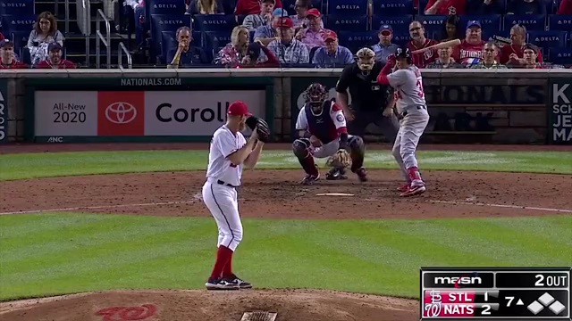

Slide 3
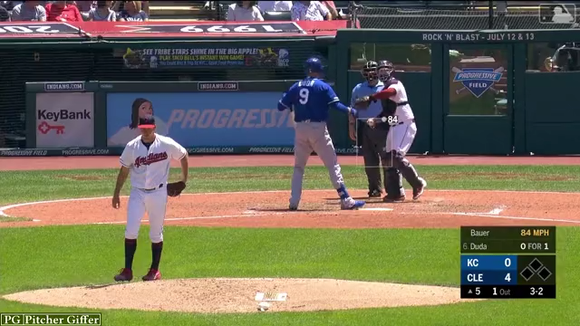

Slide 4
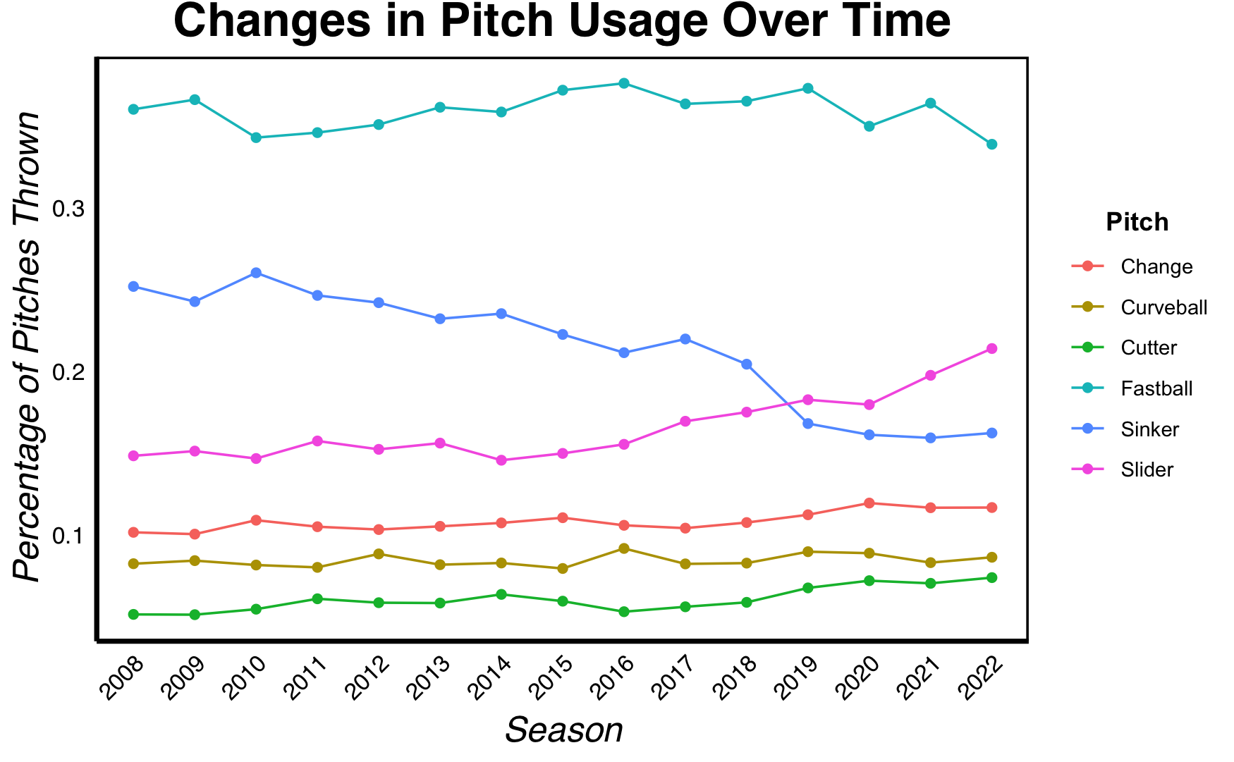

Slide 5
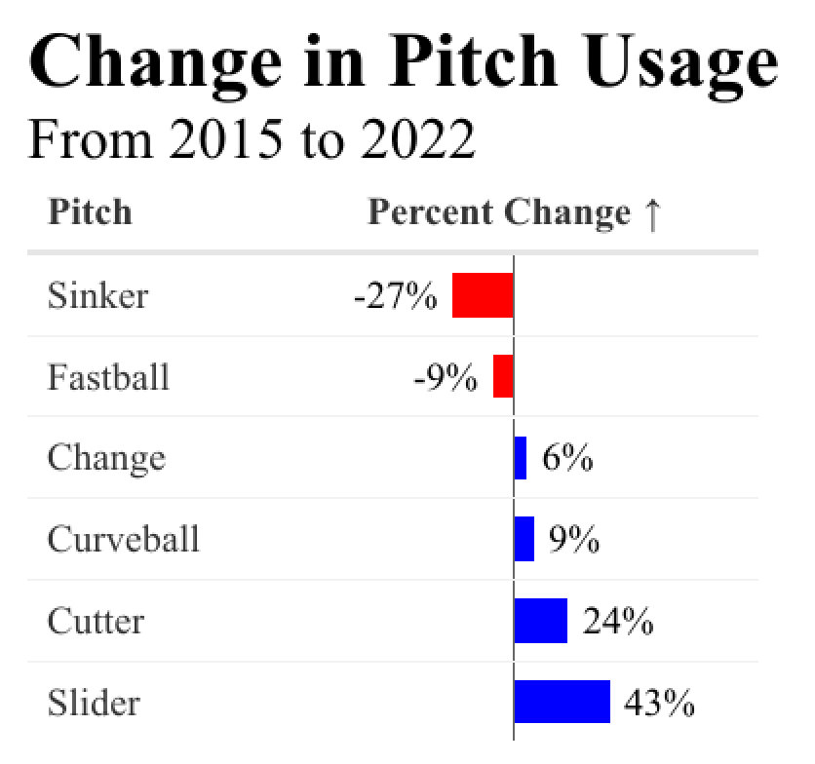

Slide 6
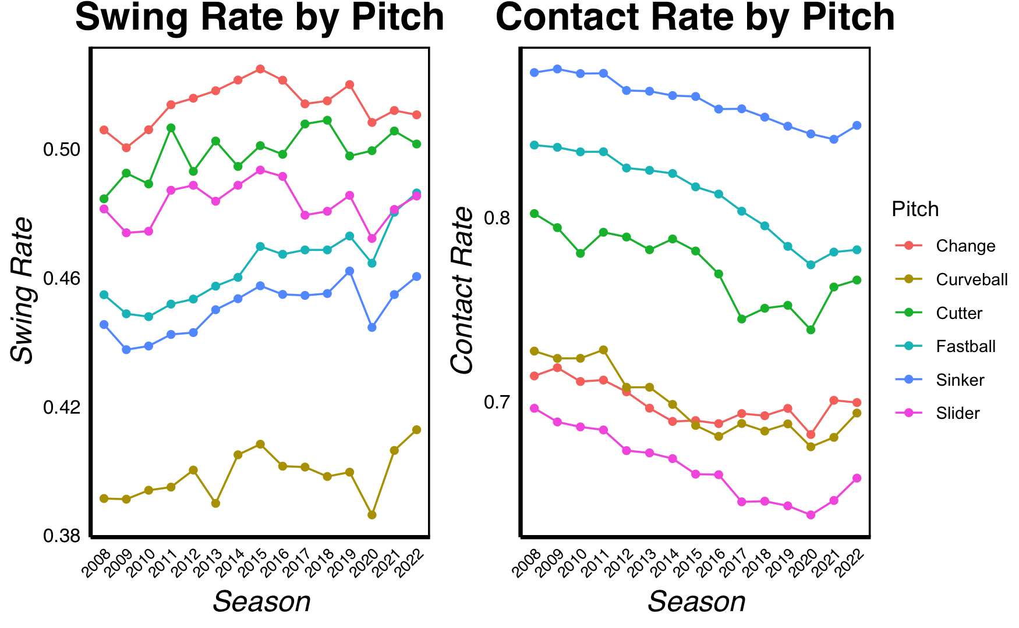

Slide 7
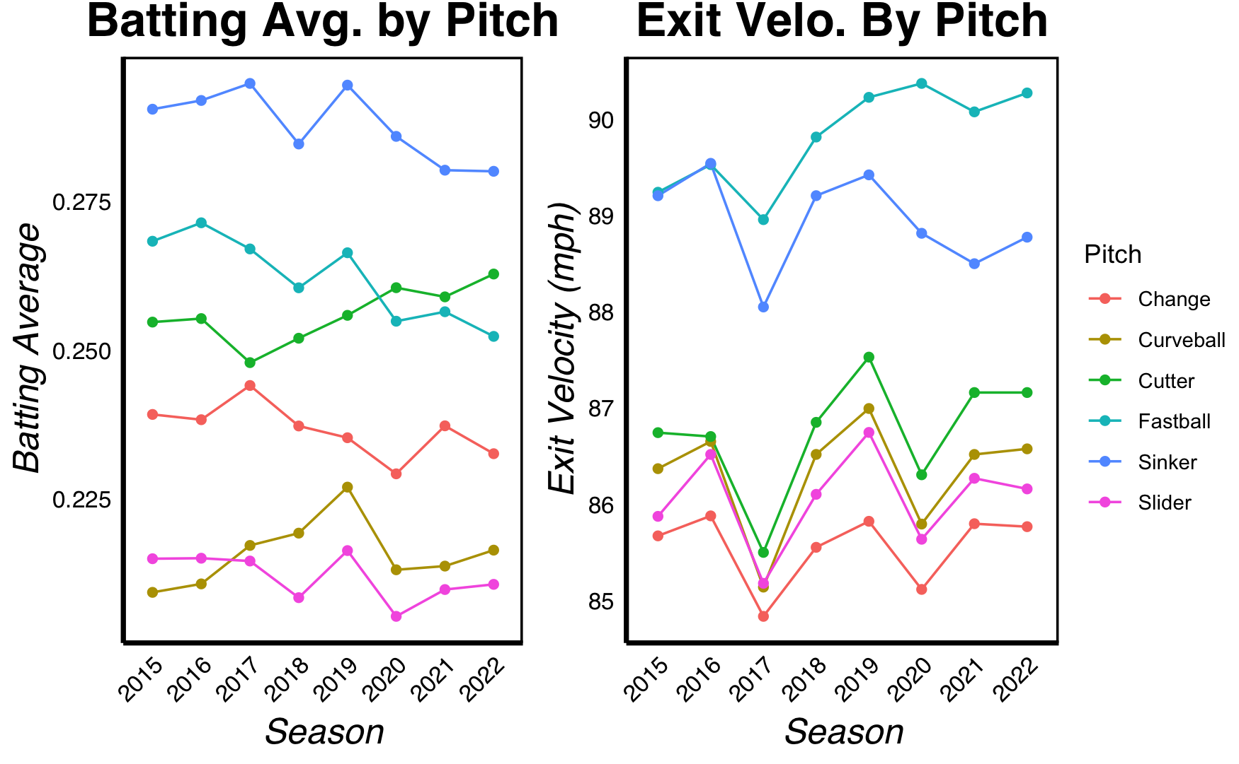

Slide 8
slider_whiff_model <- lm(Whiff Percentage ~
Velocity + Spin Rate + Release Extension +
Horizontal Break + Vertical Break + Rise + Tail + Zone)

Slide 9
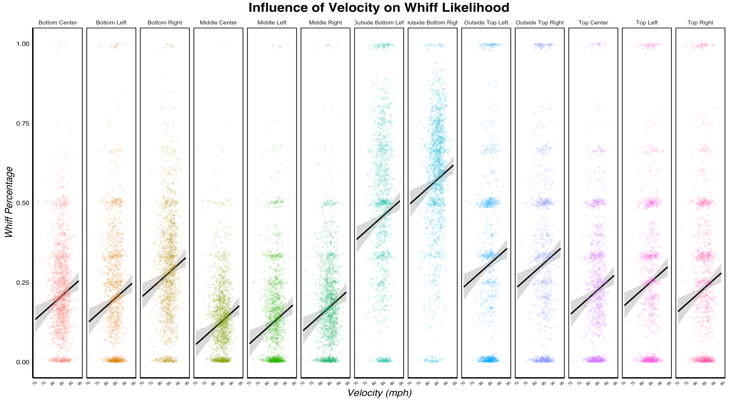

Slide 10
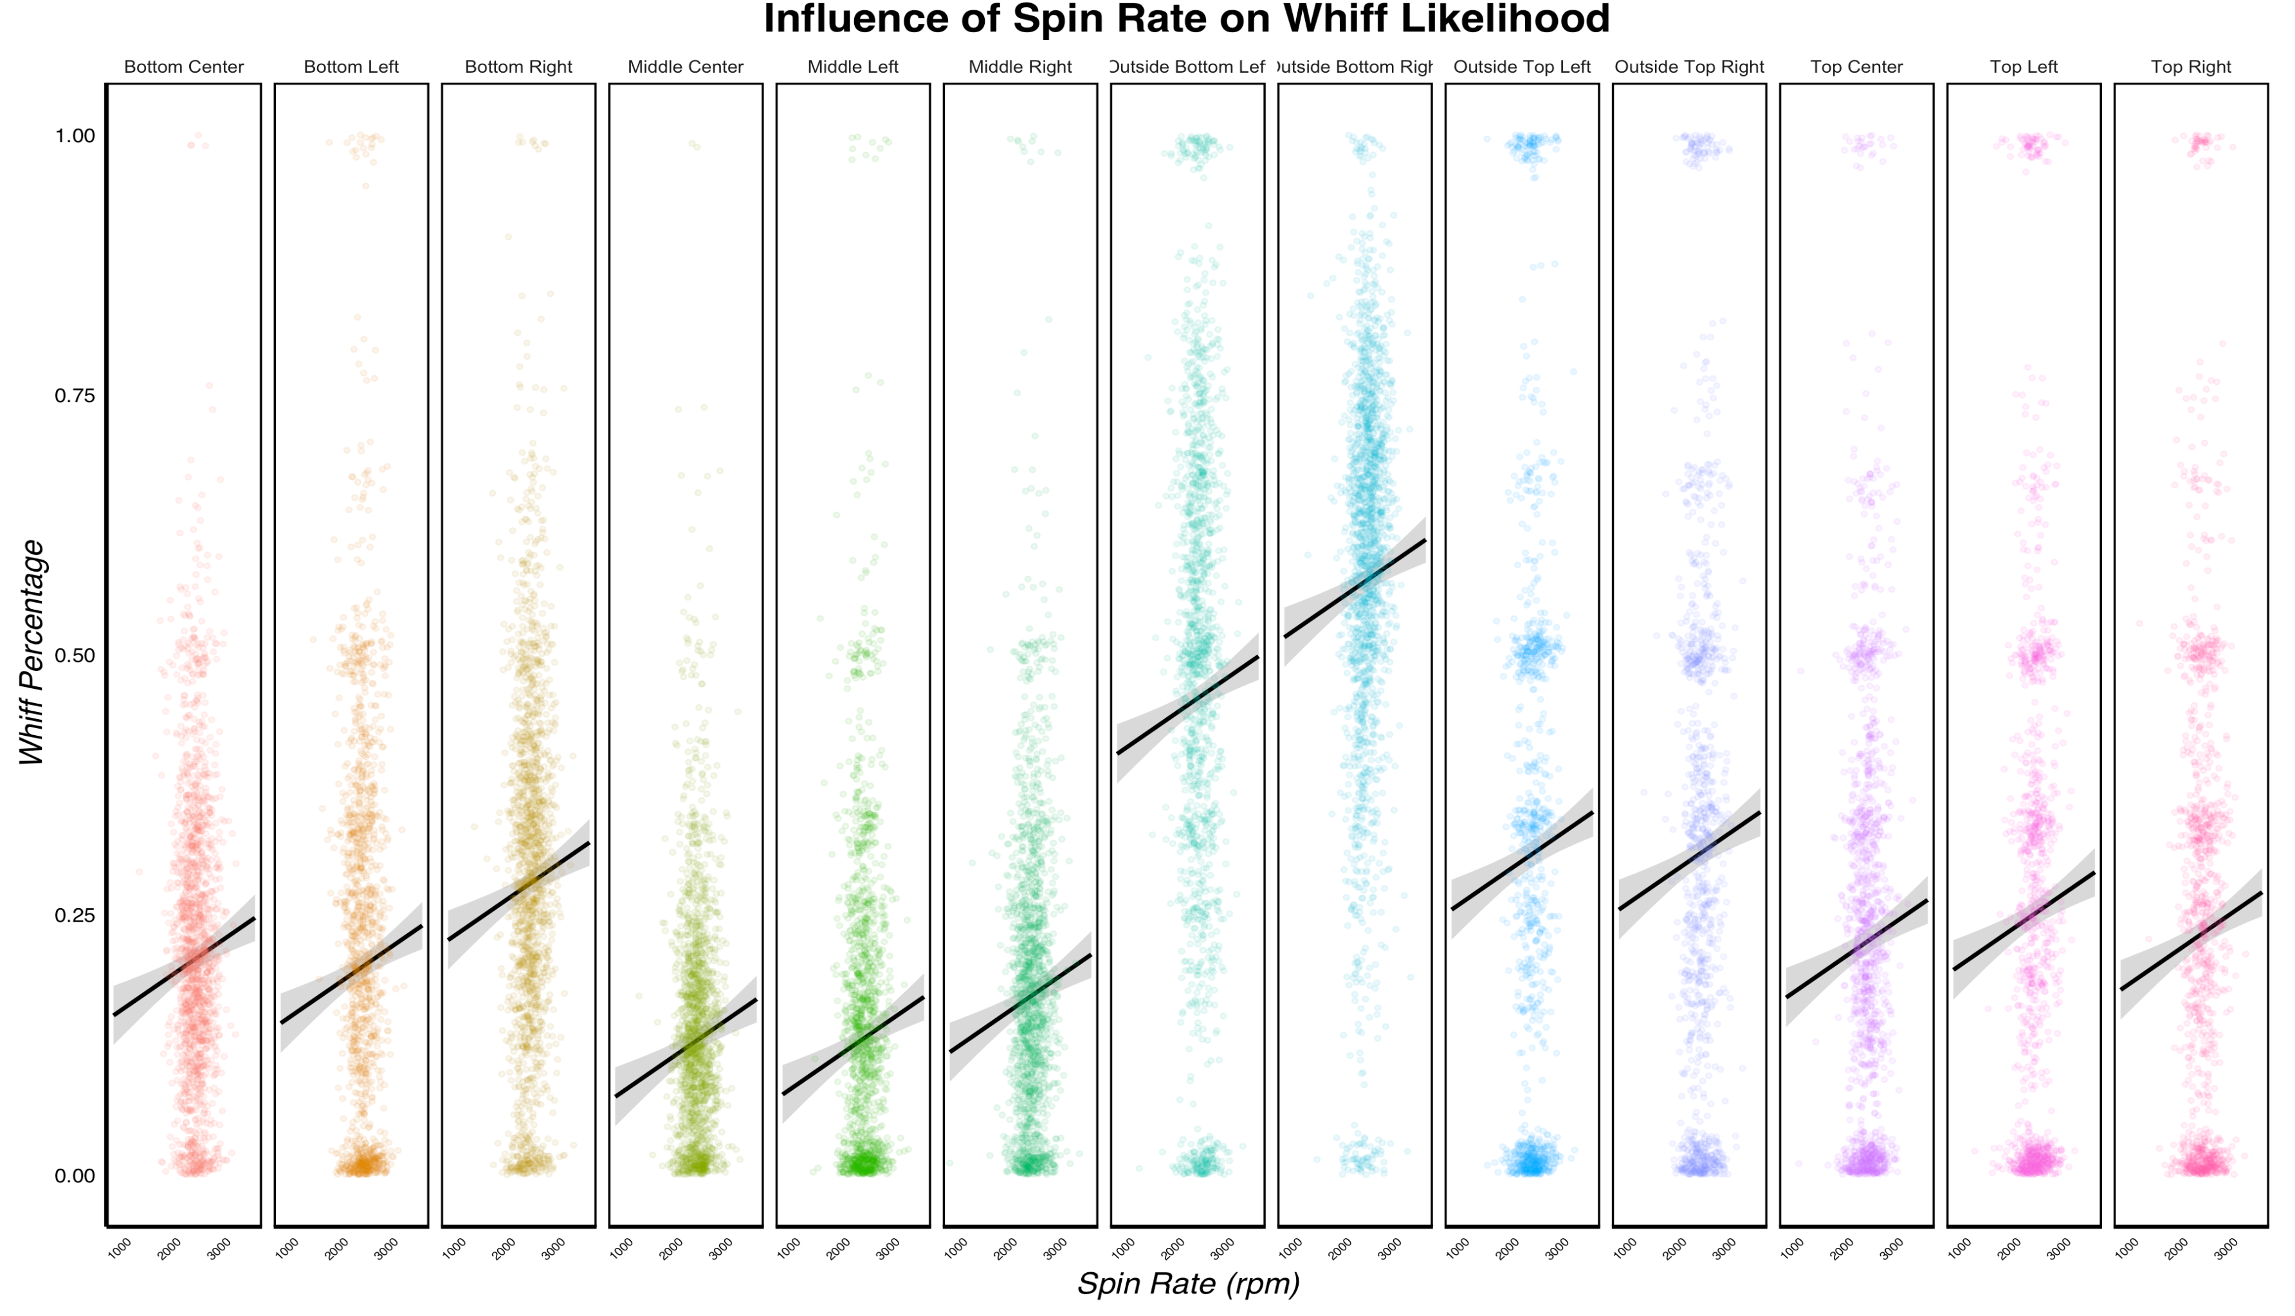

Slide 11
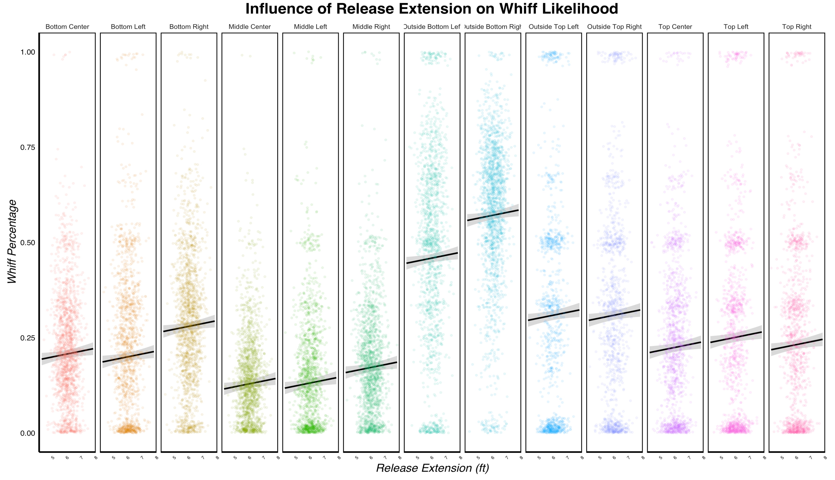

Slide 13


Slide 14
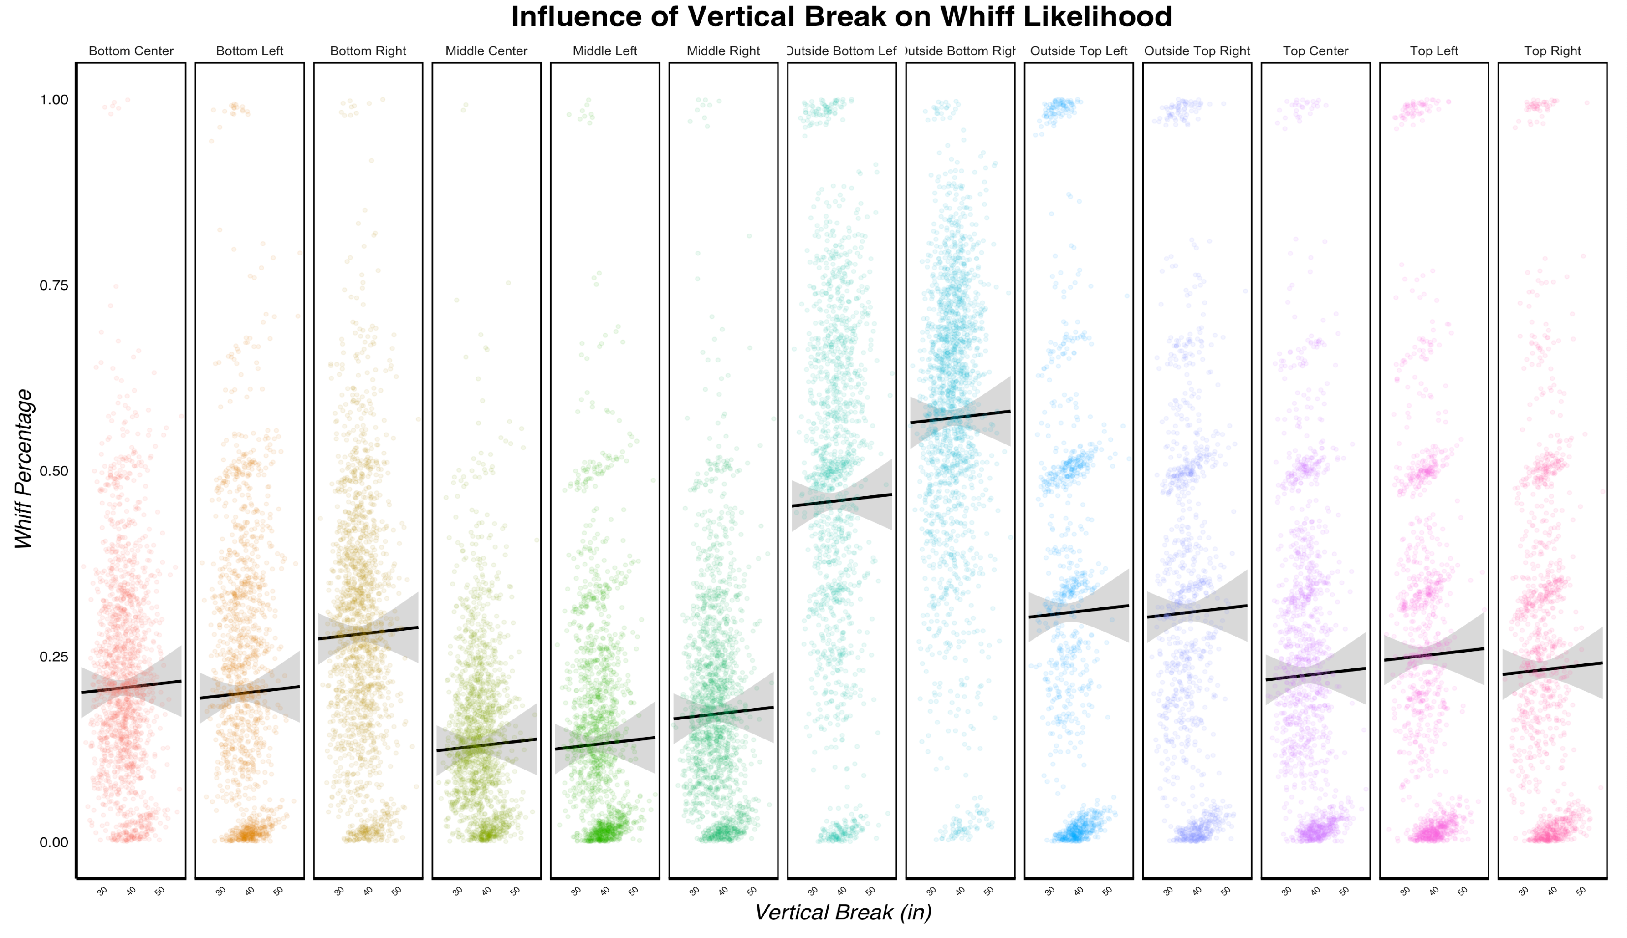

Slide 15


Slide 16
Conclusions
Maximize velocity, spin rate, and release extension
Develop vertical break over horizontal break
Minimize pitch rise
Pitch the slider low – preferably out of the zone

Slide 17
Future Directions
Analyze data by pitcher- and batter-handedness
Look at the interactions between movement types
Explore the influence of other factors:
Pitch count
Previous pitch(es)
Game situation
Review relationship between pitch factors and injury risk
Is the benefit worth it?

Slide 18
Acknowledgements
Data:
Obtained from Baseball Savant
Collected by Trackman and Statcast
Key R packages used:
dplyr
ggplot2
ggforce
visreg

